Slide 1
DIASPORIC AUSTRALIANS AT A GLANCE (WWW.DAAAG.ORG): A PILOT STUDY TO PRESERVE THE CULTURAL HERITAGE OF AUSTRALIA’S 210 ETHNIC GROUPS
Dr Nonja Peters, Director
History Of Migration Experiences (HOME) Research Unit
Mobile + 61 (0)414 700 289
Email N.Peters@curtin.edu.au

Slide 2
Aims of the Project
The aim of the History Of Migration Experiences (HOME Research Unit) is to bring together national and international partners to develop the collaboration – working title:
Diasporic Australians At A Glance (DAAAG) Virtual Immigration Portal (VIP).

Slide 3
Why go digital?
High cost of traditional museum practices to reflect the nation’s diversity and access to collections.

Slide 4
The American Family Immigration History Digital Center Located in the Ellis Island Immigration Museum, the American Family Immigration History Center (AFIHC) allows visitors to digitally explore the extraordinary collection of immigrant arrival records stored in the Ellis Island Archives.
Launched at Ellis Island in 2000, the AFIHC receives approximately 9 million hits per day.

Slide 5
Launch 3rd Phase WA Welcome Walls. It’s 40 degrees at 10am and still the interest!

Slide 6
Mutual Heritage
Australia’s immigrants originate from 210 countries.
The migration process generates material and immaterial relics of the past which we collectively refer to as ‘common cultural heritage’ or mutual heritage.

Slide 7
The Nature of Migration
Migration is, by its very nature, a ‘mutual heritage activity’ since all migrants leave documentary traces of their past in the memory institutions of their country of origin and move records of their present and future into the archives and libraries of their receiving society.

Slide 8
Relevant Databases
Birth, death and immigration records, shipping lists, passport requests, health clearances, Alien registration, citizenship papers and school or business records. Photographic and ephemeral databases plus any other documentary evidence.

Slide 9
Research Question 1
How can we best negotiate these traces and records in digital forms and enable access to the dual interacting histories they represent?

Slide 10
Research Question 2
What ethics and protocols pertaining to privacy and copyright issues do we need to inaugurate for the digital collection and accessibility of migration documentation for historical, sociological and family research?

Slide 11
The Challenge
The most significant challenge, therefore, is to establish or utilize an existing single digital resource and dedicate it to providing interoperable electronic access to relevant archival databases, in all relevant countries currently not available or difficult to access for researchers and the public.

Slide 12
Final Product
Our ultimate aim is to develop a ‘best practice’ dynamic, easily navigable, multimedia easily accessible single digital eMigration collection.

Slide 13
Outcome
By maintaining, managing, using and highlighting our migrant heritage, we can foster a critical reflection on our past and a mutual understanding of past, present and future.
This can promote ‘cultural diplomacy - cooperation between countries, both bilaterally and multilaterally whose history intersects with Australia’s via immigration.

Slide 14
As well as serving the duty to remember, the focus of this initiative is to acknowledge, integrate and build awareness of the migration experience and obviate the tyranny of distance.
Acknowledge: The contributions made by migrants to their host societies; the diversity and wealth of the origin cultures and; the right to a dual-belonging.

Slide 15
Dutch Template Pilot Project
We have had Discussions with:
Curtin University
University West Sydney
Huygens ING Institute The Hague
National Archives, The Hague
National Archives, Canberra
Australia National Maritime
ANU European Studies Centre, Museum, Western Australian Museum, NLA, WA State Library, ANSWA (Dutch Community).
Immigration Museum in Adelaide and Melbourne
National Library & Archives Ireland & England
National Library & Archives Germany
National Library & Archives Italy & Greece

Slide 16
Australian-Dutch Heritage Day 14 june 2012
Creating a theoretical framework:
combining communities
From attic to database: Migrant registration cards Marijke van Faassen, Huygens ING
From database to community: DAAAG and Dutch Migration Heritage
Nonja Peters, HOME Center, Curtin University

Slide 17
Memory is the treasury and guardian of all things – Marcus Tullius Cicero
From attic to database Migration registration cards

Slide 18
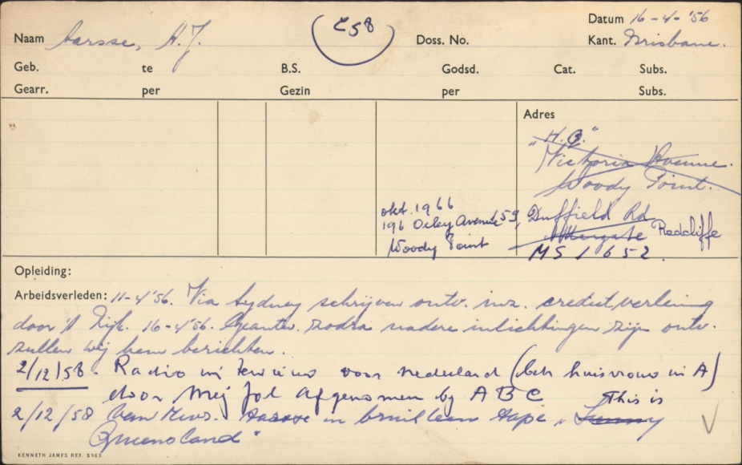
Registration cards of Dutch migrants to Australia
National Archives The Hague
51.525 registration cards of emigrant units

Slide 19
Registration cards of Dutch migrants to Australia
Characteristics
1946-1982
cover about 135.000 Dutch emigrants ( ca. 87%)
made up by the Dutch migration officers abroad
Contents
‘Hard facts’ on composition of family, dates of birth, addresses, religion, marital status, date of arrival, carriers, port of entrance, scheme
‘Soft facts’ on vocational training or profession, ‘microstories’ on problems (financial, divorce, juridical and the ‘networks’ of assistance)

Slide 20
Are there other sources?
There is more information on the same persons in other Dutch archives
The Australian government kept there own files on these migrants from the moment they decided to emigrate (applicationforms etc.)

Slide 21
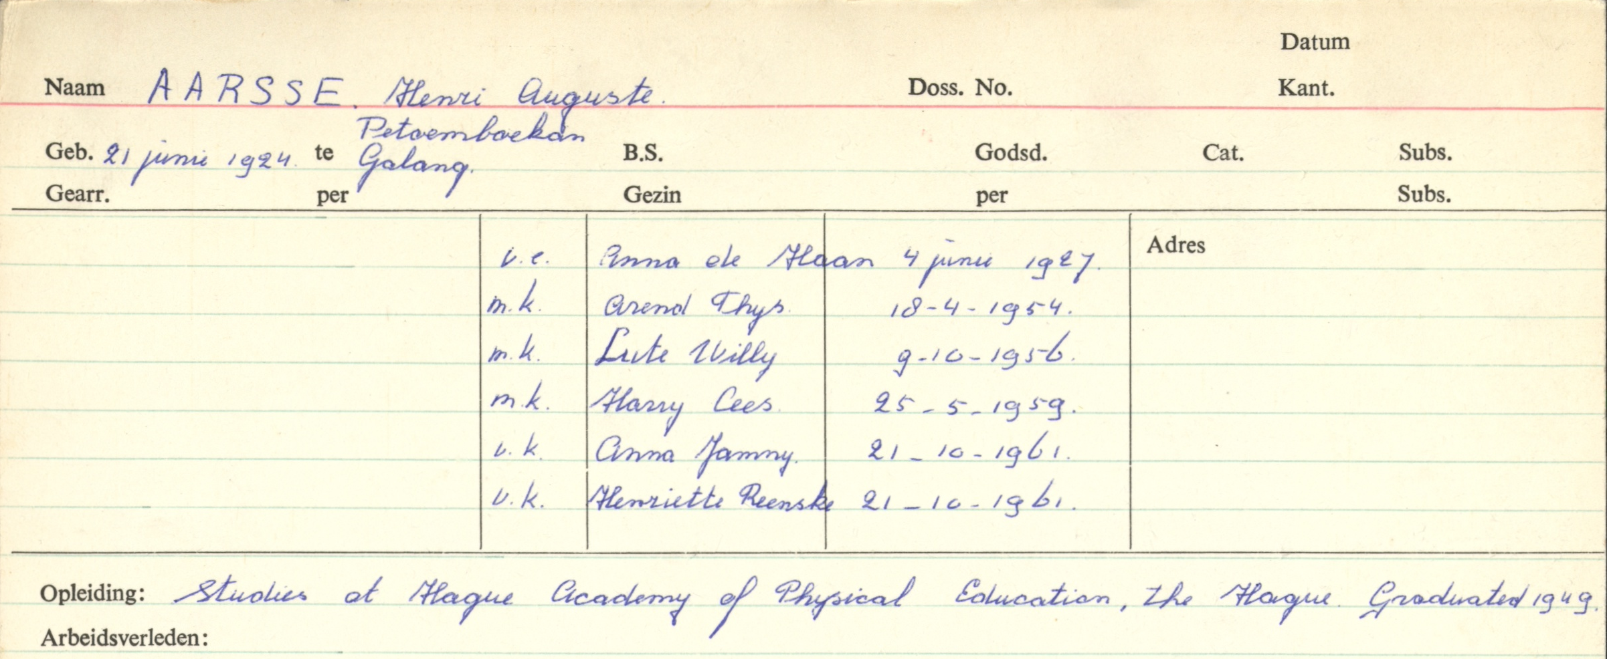
Example
National Archives The Hague: search for “Aarse”
7 hits; 2 results shown
Aarsse , Henri Auguste Aarsse, A.J.

Slide 22
Example
National Archives Australia: search for “Aarse”
17 hits; 5 results shown, two digitized files

Slide 23
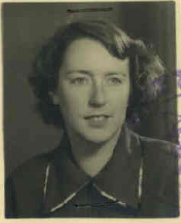
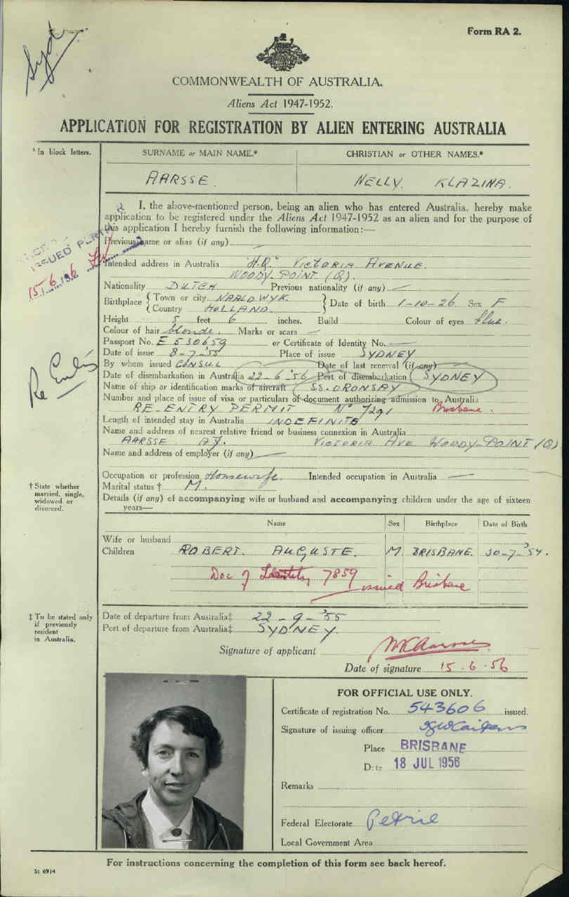
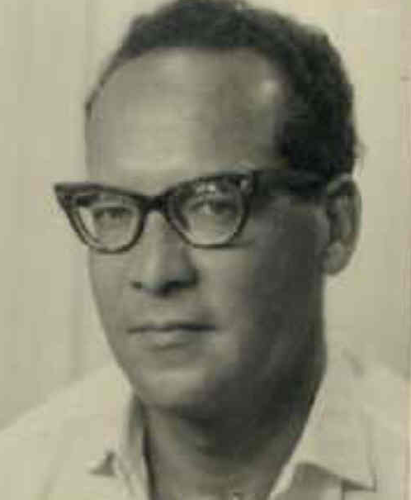
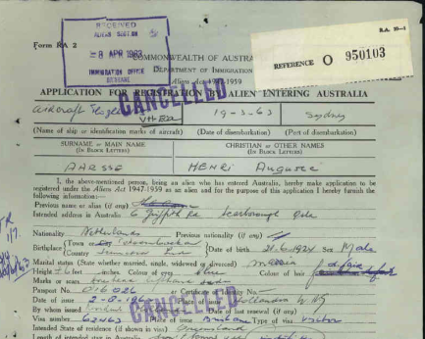
Connection
Klazina Nelly Aarse-Smit (NAA, item BP25/1) = spouse of Aarsse, A.J
Henri Auguste Aarsse (NAA, item BP25/1) = brother of Aarsse, A.J.
Aarsse-Schoggers, Henriette J. (NAA, item BP299/1) = mother

Slide 24
COMBINING COMMUNITIES Two initiatives, several target groups, one site.
What does it look like?
Research communities
Huygens ING: building an ‘enriched’ database on migrants registration cards
Curtin University (and partners): developing
HOME
Migrant / research / commercial communities: using and enriching

Slide 25
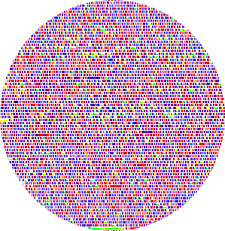

Slide 26
Aarsse, Henri Auguste and his family
Personal information
Date of arrival: 19xx
Port of entrance:
Carrier:
Aarsse, Henri Auguste
Head of family
>>
Spouse >>
Son >>
Daughter >>
Archival information
Additional files can be found in:
Nationaal Archief
Den Haag
National Archives Australia
Brisbane, Canberra
Do you have extra information about Henri Auguste Aarsse and his family?
Add information in the Community:

Slide 27
NAME, Surname and family
Personal information
dead database
Archival information
contains external links, can be enriched by research community
Do you have extra information about Name, Surname and his family?
Add information in the Community
virtual safe function

Slide 28
Sustainability Our vision is to develop the processes and methodology needed to produce a sustainable template for the digital preservation of Dutch Australian’s cultural heritage that is transferable for use by Australia’s 210 ethic groups.

